Slide 1
Admin info
This presentation should just be viewed by administrators.
The idea of dinner choices is to keep the teacher role as minimal as possible, thus not requiring them to get involved with the running of dinner choices.
If more than one person opens any single sheet at a time then conflicts can occur, thus best if only the administrator touches the admin side and the teachers keep to their classes sheets.

Slide 2
Contents
What is dinner choices?
A little bit of background information about the folder structure before we start
Setting up Dinner Choices for the first time (or for a new year)
How does the administrator use dinner choices on a daily basis?
Sending dinner choices to the classes
Receiving the dinner choices
Locating individual pupils choices
Adjusting pupils choices
How does the administrator modify dinner choices?
Adding/Removing/Setting classes of pupils out
Adding/Removing individual pupils
Long term selection of a pupils choices
Finally
How to enable macros

Slide 3
(1) What is Dinner Choices?

Slide 4
What is dinner choices?
Allows pupils to choose the meal they desire.
Empowers the pupils to make a choice.
Enables the canteen to produce the correct amount of each meal every day.

Slide 5
(2) A little background information before we start

Slide 6
Word of warning
Although many people can open a single spreadsheet only one person can have control over it, all others are “Read-only”. But even by viewing a spreadsheet (or accidentally keeping it open) it can mean a spreadsheet can’t be deleted or modified!
So with that in mind lets look at the folders and understand the reason why they’re split into Admin and Classes sections.

Slide 7
The folders (top level)
Admin
This folder should only be used by the administrator (see the admin folder section for more details)
Classes
This folder should only be used by teachers. It should only be populated when the administrator has sent the dinner choices and before the teachers have completed their daily choices.
This folder should be empty after all the choices have been made.

Slide 8
The admin folders
Admin.xlsx
- The current administrator sheet. Used to set the daily dinner choices and also the classes to which the dinner choices are sent.
- Gives the status of all the classes and the dinner choice totals.
Original folder
Contains the original unpopulated admin.xlsx and classes.xlsx files which need to be populated
+ Original/class_lists folder which contains the original class lists. (This folder is used when setting up the classes first time!)
Default
Contains the class spreadsheets with default dinner choices ready to be populated by the admin.xlsx sheet when sent out to the teachers.
Current_empty
When the administrator creates the individual class spreadsheets a copy of these clean spreadsheets are placed in this directory so that if any error is made then either the clean spreadsheet can be copied to the “classes” directory or the clean spreadsheet analysed for errors.
Complete
When a class has completed their choices, this is the directory where they’re sent.
User_guides
This is the location for the user guides.

Slide 9
Original (is used to setup the default folder with a new year of pupils)
Done
Once
Default folder (spreadsheets don’t contain choices but have the class/pupil information)
Admin.xlsx (Daily sets meal choices and sends the classes
Current Empty (used in error cases to confirm what was sent)
Empty sheets also saved
Classes (the spreadsheets are ready for the teachers
Teachers complete their classes
Competed (Admin.xlsx is updated with the totals for the administrator to view)

Slide 10
(3) Setting up Dinner Choices for the first time (or for a new year)

Slide 11

First of all copy the previous installation!
If a previous installation is available I highly recommend you copy it!
The new installation could have faults!
The new installation may not work first time!
By copying the old implementation you have something to refer back to!
E.g. You should have a directory like so (however even this isn’t great since a teacher may mistake which folder to use so it might be best to move the copy):
The “default” directory should be emptied (delete any old class files from this directory)
The “admin.xlsx” in the admin directory should also be deleted.

Slide 12
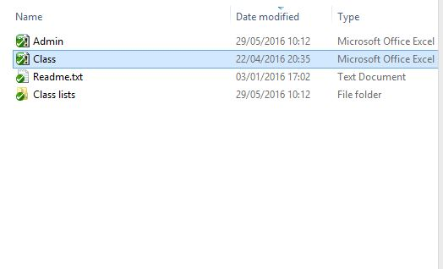
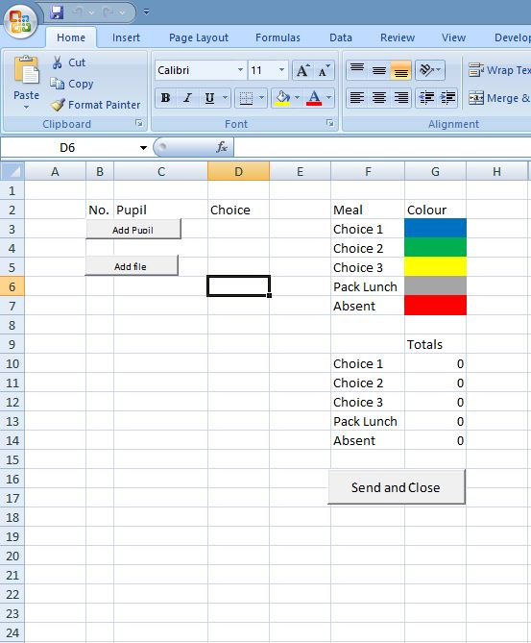
Setting up the classes (1)
Within the directory:
Dinner_choices\Admin\original
Is the excel sheet Class.xlsx
This sheet should not be updated! Instead if you open it you see the following:
These are the only files that should be in this directory
Note the “add file”

Slide 13
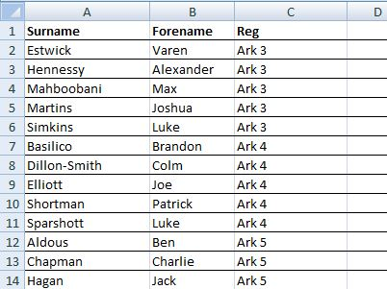
Setting up the classes (2)
If you click the add file button you can then choose to take the data from another xls file. Examples of input files can be found in the “class_lists” directory.
These lists were extracted from SIMMS(?)
A simple class can be used or the whole year can be processed at the same time e.g. See the “Names for Dinners.xls”.
NOTES:
The order of the columns must be SURNAME, FORENAME and CLASSNAME.
The first pupil must be in the second row.
If more than one class is in a single excle sheet then the classes must be grouped together! (E.g. As shown)

Slide 14
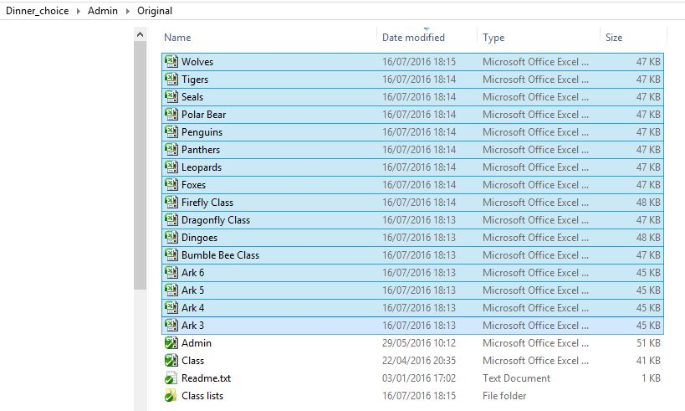
Setting up the classes (3)
If an excel containing the whole year is used then the output in the “original” directory should be like this:
The new class files can now be cut and pasted from this “original” directory into the “default” directory.
Don’t move the original “admin” or “class” files
This completes the class setups! (Although it maybe wise checking they’re correct)

Slide 15
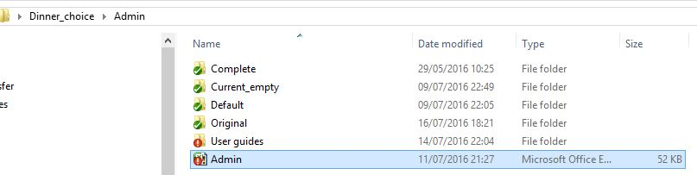
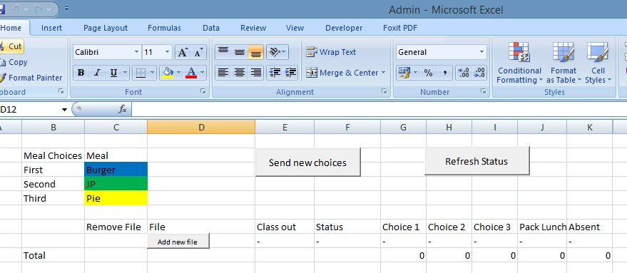
Setting up the admin.xlsx (1)
The “admin.xlsx” file in the original directory should be copied into the “admin” directory.
Open this file and it should be empty:

Slide 16
Setting up the admin.xlsx (2)
Clicking on “add new file” then select the desire class in the “default” directory.
Repeat this until all classes have been added.

Slide 17
(4) How does the administrator use dinner choices on a daily basis?

Slide 18
Admin.xlsx (1)
On a daily basis the administrator just needs to know about Admin.xlsx, I.e.
Set the dinner choices before the teachers require them
Receive the dinner choices when the teachers have completed them and pass the information to the canteen
The following slide give the steps to do this.

Slide 19
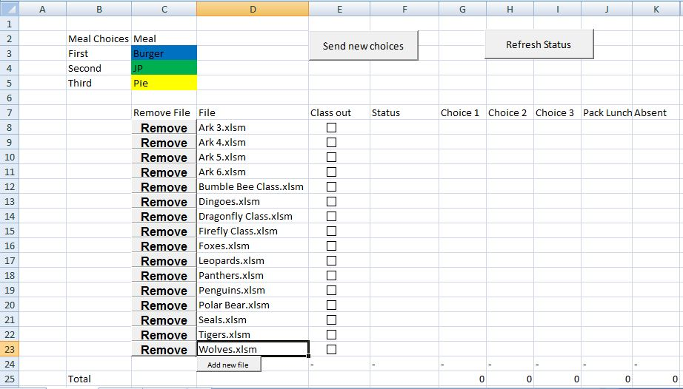
Admin.xlsx (2)
3. Send the choices
4. Refresh when teachers have completed
1. Fill out the dinner choices
2. Tick any classes out
5. Confirm the numbers and send to canteen

Slide 20
Completed Classes
To look up a completed class when the class is completed then the class choices will be in the completed folder.
You can adjust the choices for individual pupils i.e. If they chose wrong or are in late.

Slide 21
If a class is completed completely wrong!
(A wrong sheet could be because it contains the wrong set of choices)
The uncompleted empty dinner choices spreadsheet for all classes can be found in the “current empty” directory.

Slide 22
If all else fails
Delete all the sheets in the classes folder (note if teachers have them open then they have control so you may not be able to delete).
And resend from the Admin.xlsx sheet.

Slide 23
(5) How does the administrator setup dinner choices?

Slide 24
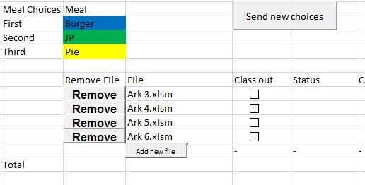
Adding/Removing classes of pupils
If a class is no longer needed then they can be deleted from Admin.xlsx (see arrow A below)
If a class is out then the “class out” checkbox can be ticked to remove that class from being sent for that day. (See arrow B below)
B
A

Slide 25
Adding/Removing individual pupils
Instead of updating the entire class in one go you can now add and remove pupils by using the add and remove buttons in the individual classes in the “default” folder!

Slide 26
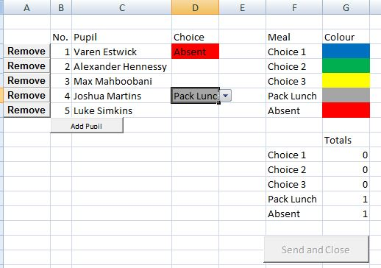
Long term selection of a pupils choices
If a pupil is long-term absent or long-term pack lunch it might be good to set then to this state before the class is sent to the teacher. This can be done by modifying the class in the “default” directory.
Of course the choices at this stage haven’t been set however assuming blue is always vegetarian then this choice can also be set.

Slide 27
(6) Finally

Slide 28
Finally
Please pass on any feedback/desired changes/enhancements which would make the teachers/canteen/pupils roles easier. This is a bespoke implementation so anything is possible.

Slide 29
(7) Enabling Macros

Slide 30
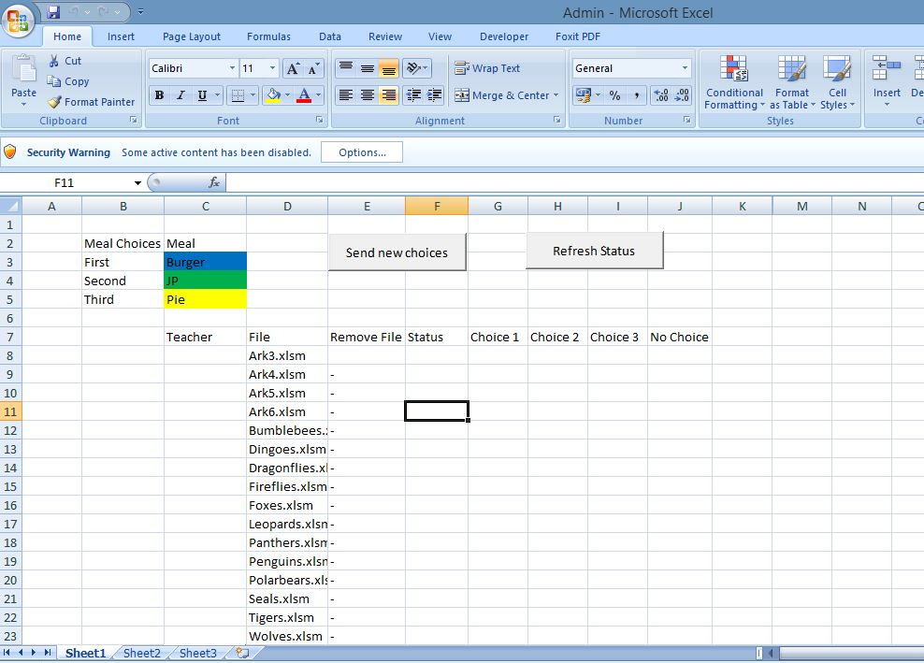
Inital warning without macros enabled
Without macros the buttons and functionality won’t be enabled

Slide 31
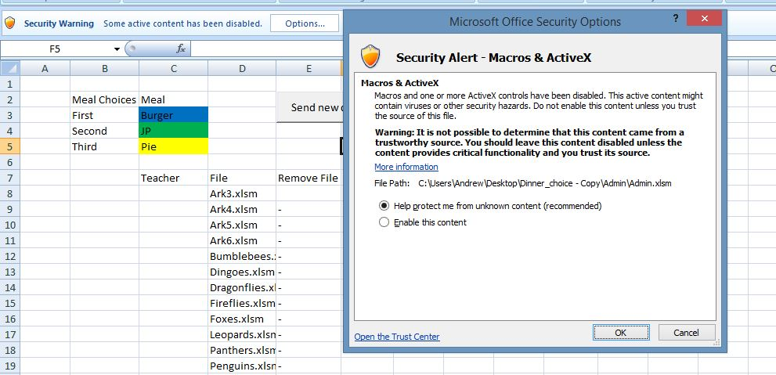
Simple enabling (not the best way)
Click on “Enable this content” and ok

Slide 32
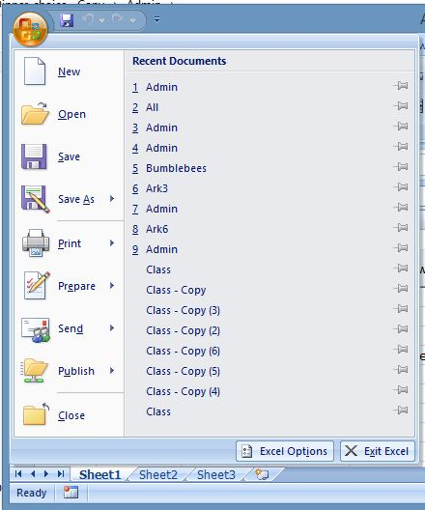
Long term you should trust the location by following these steps
Firstly click on the office button
Then open “Excel Options”

Slide 33
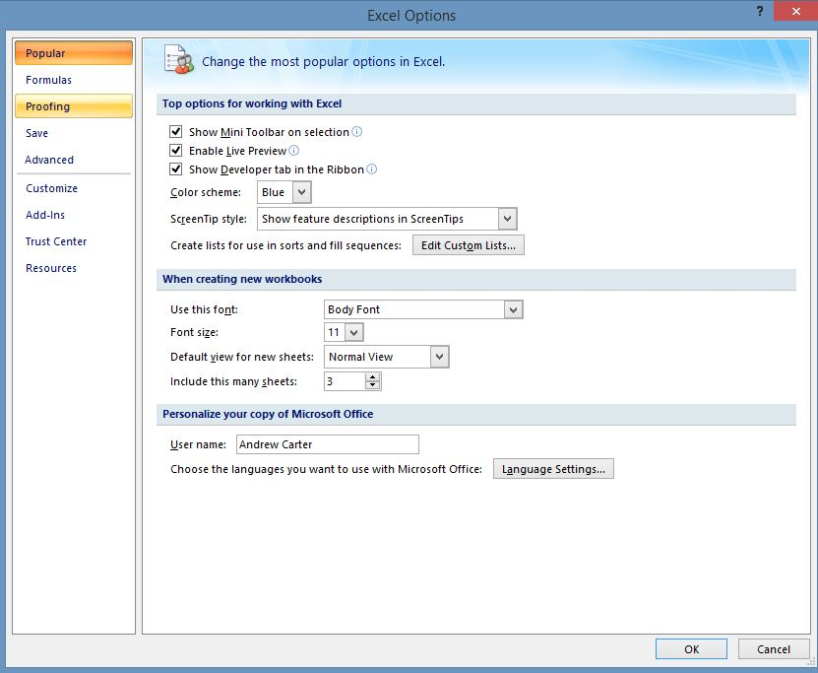
Goto Trust Center

Slide 34
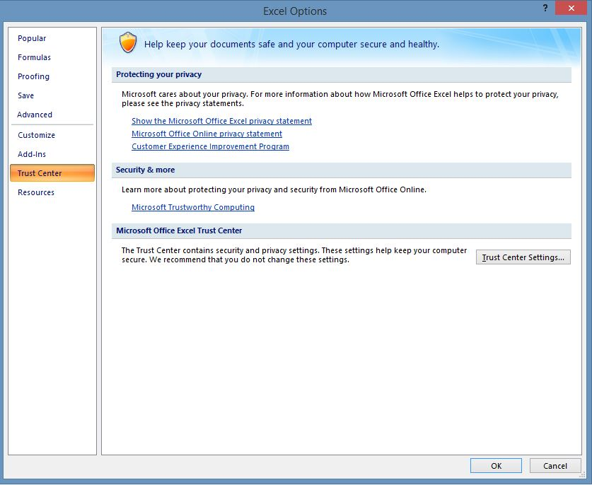
Should get you here

Slide 35
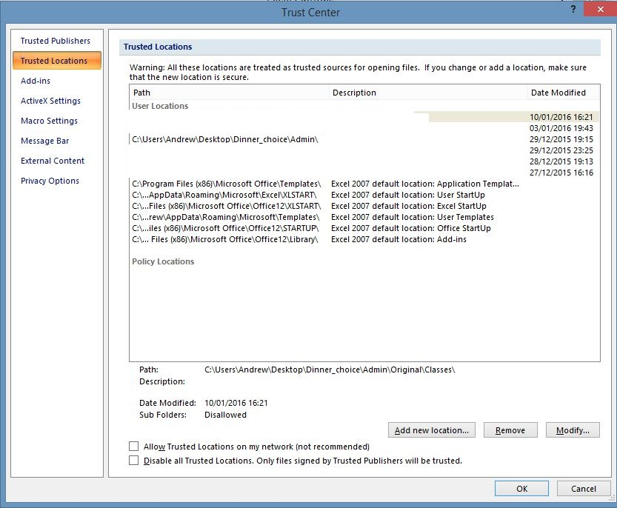
Add new location
For admin this should be the directory:
Dinner_choices\admin
I.e. Where admin.xlsm is located.

